Slide 1
Creating my First Jenkins Job

Slide 2
What are Jenkins Jobs?
Jenkins Jobs are a given set of tasks that runs sequentially as defined by the user.
Any automation implemented in Jenkins is a Jenkins Job.
These jobs are a significant part of Jenkins's build process. We can create and build Jenkins jobs to test our application or project.
When working with Jenkins, the term “Jenkins Job” and “Jenkins Project” are synonymous.
With a Jenkins Job, you can clone source code from version control like Git, compile the code, and run unit tests based on your requirements.

Slide 3
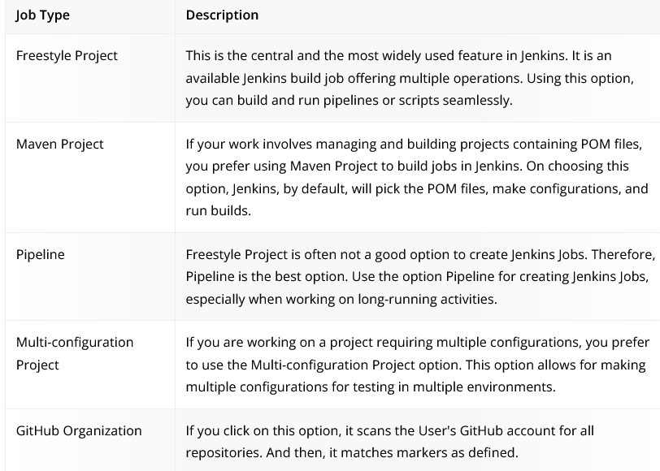
Types of Projects

Slide 4
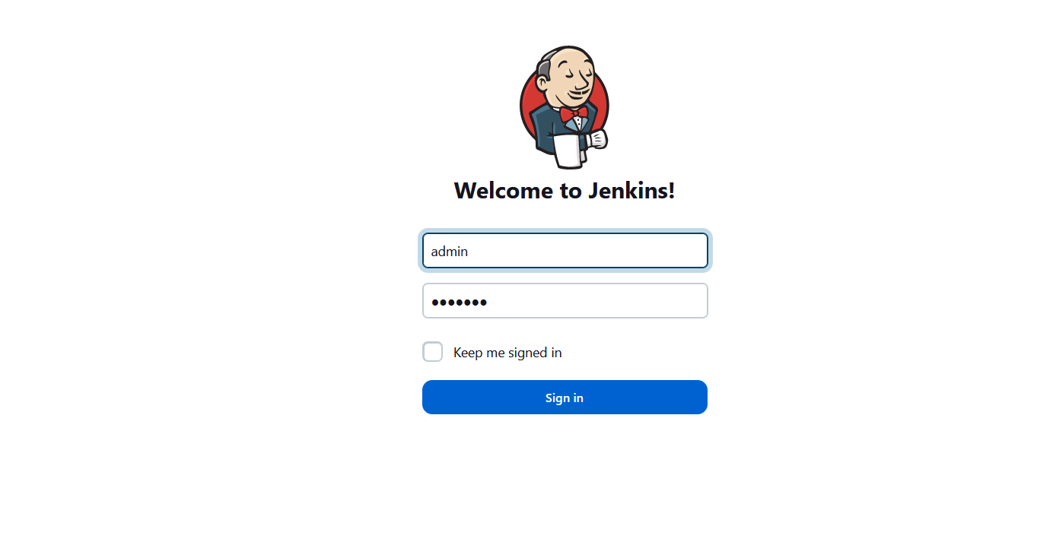

Slide 5
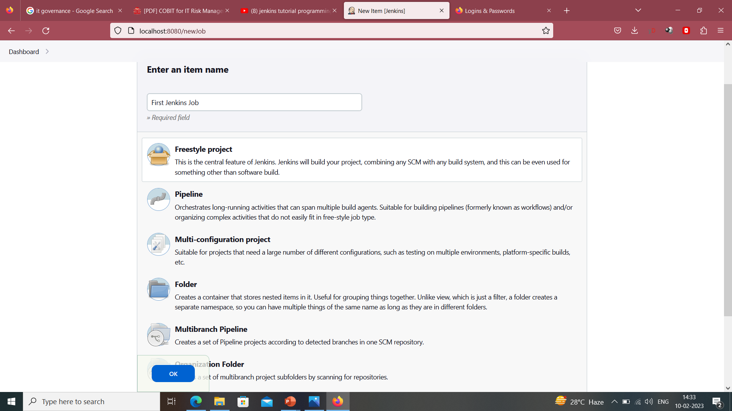

Slide 6
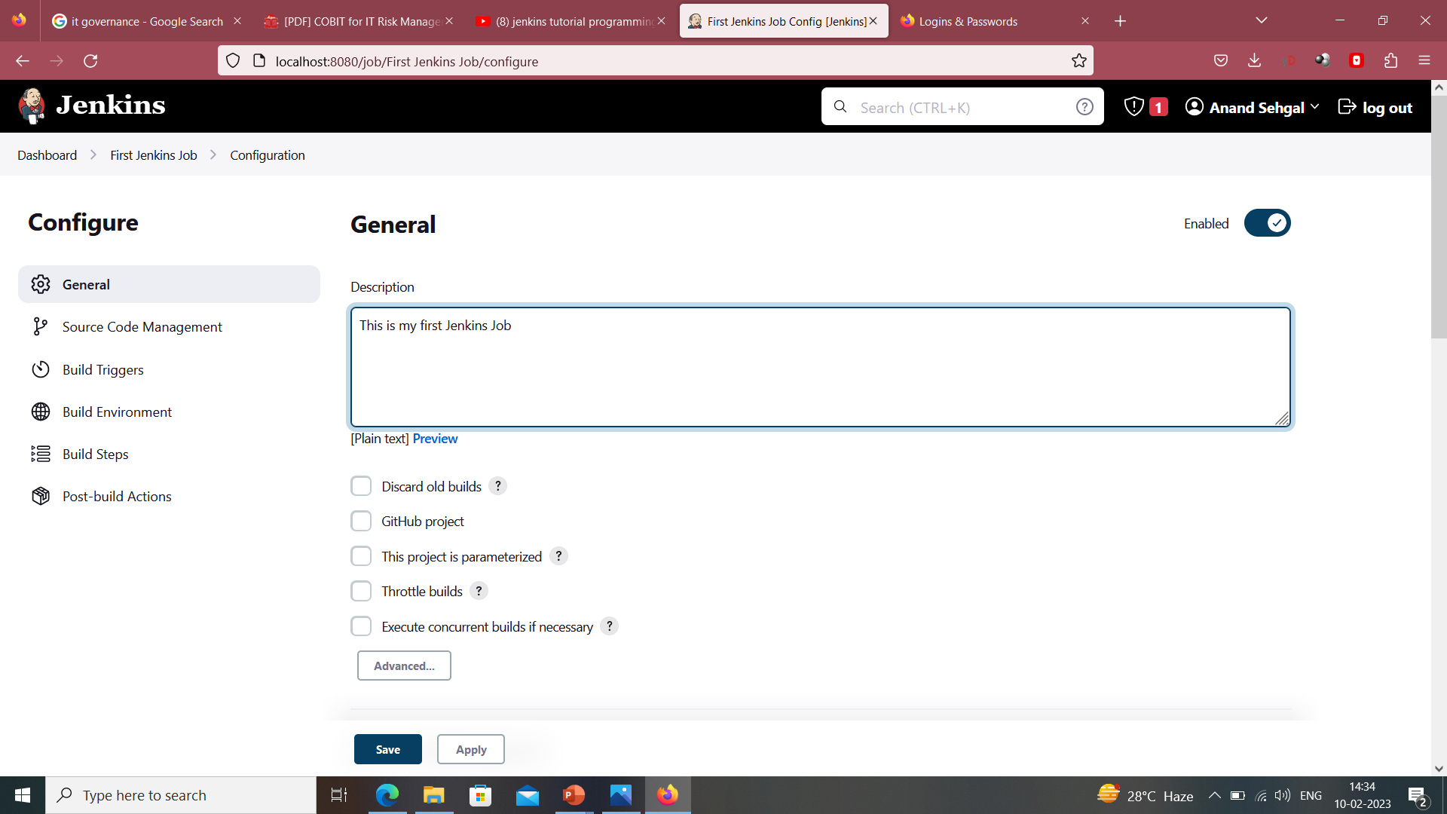

Slide 7
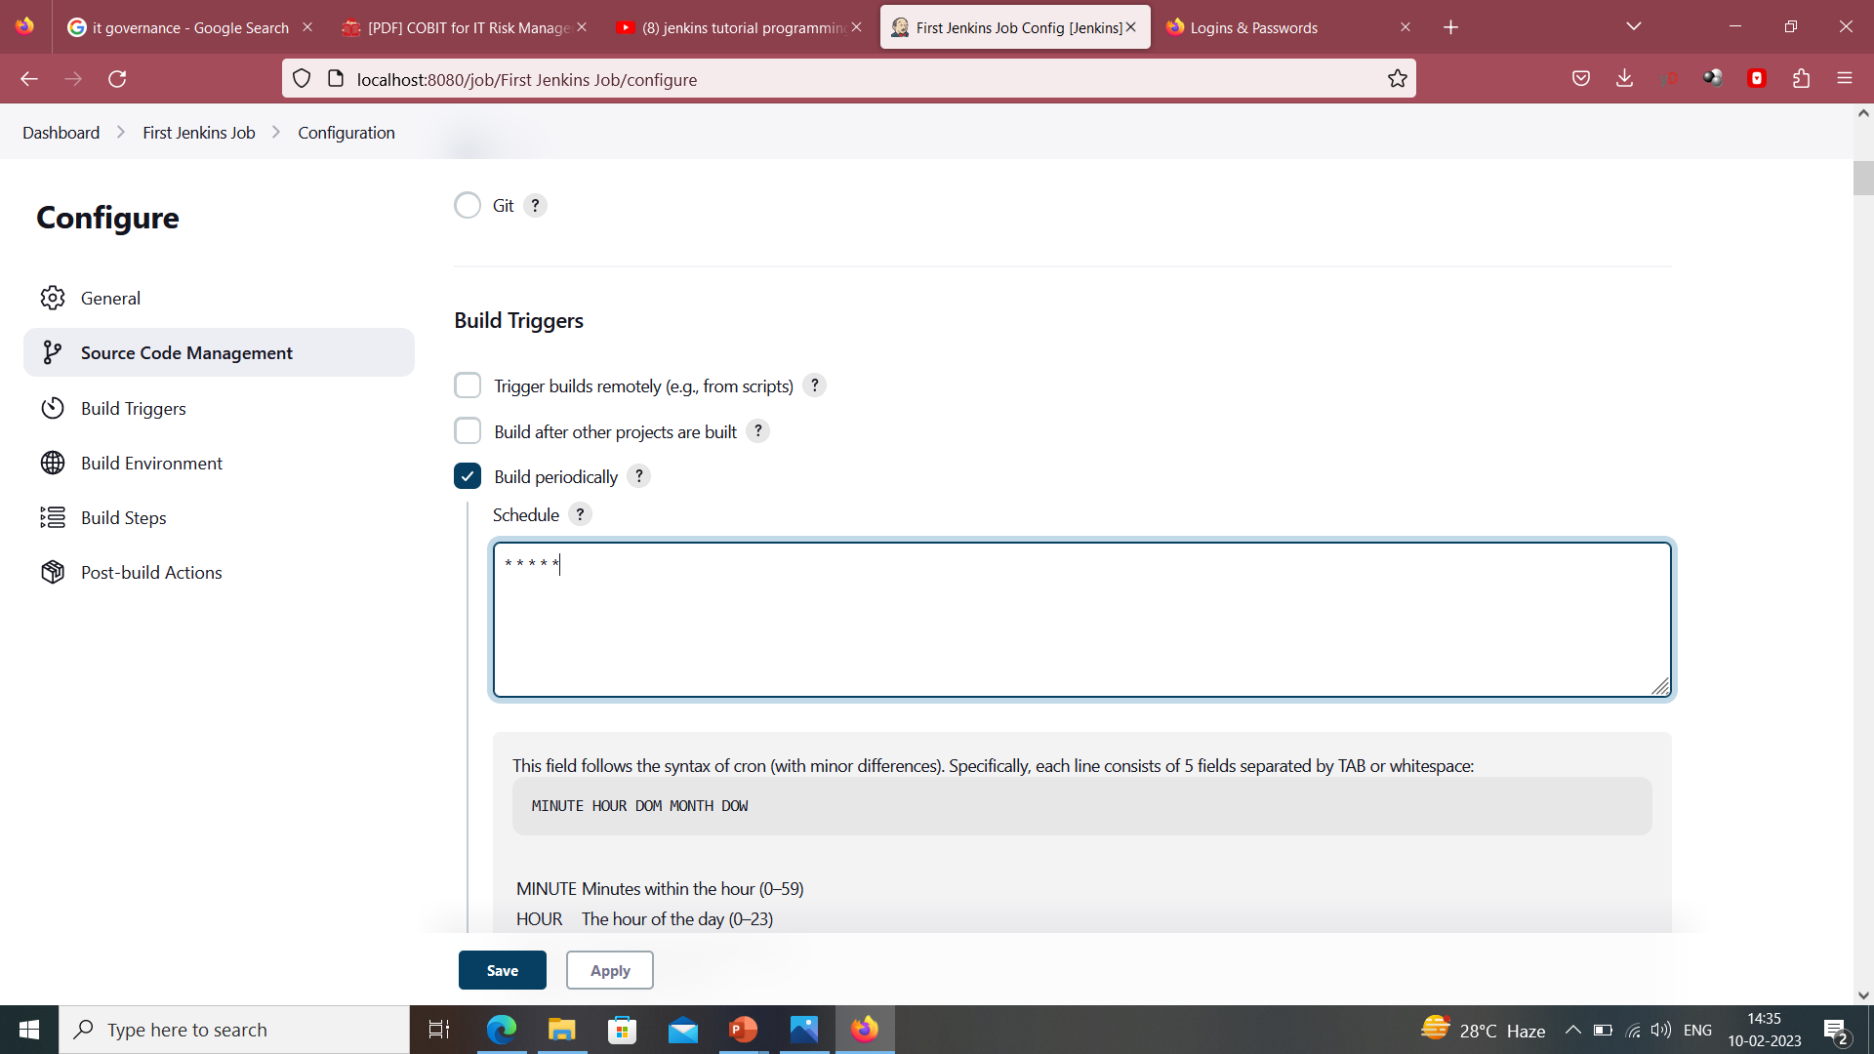

Slide 8
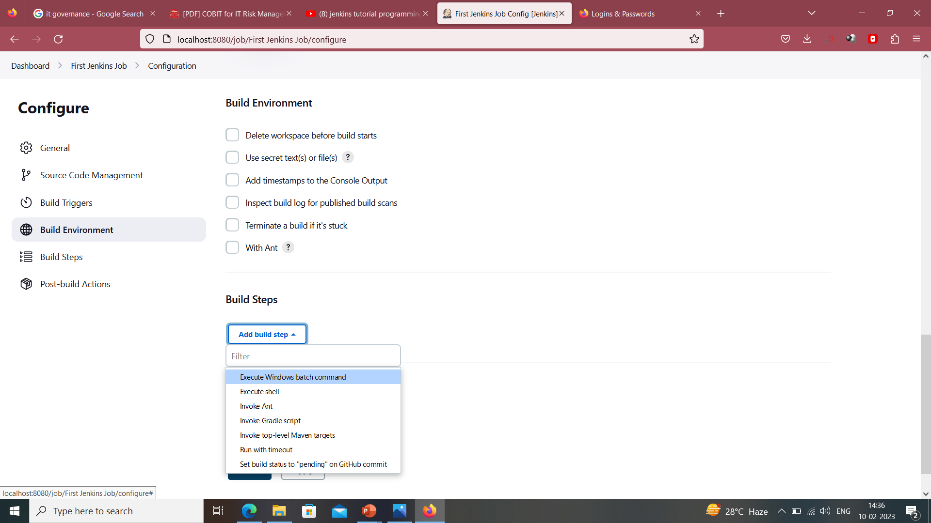

Slide 9
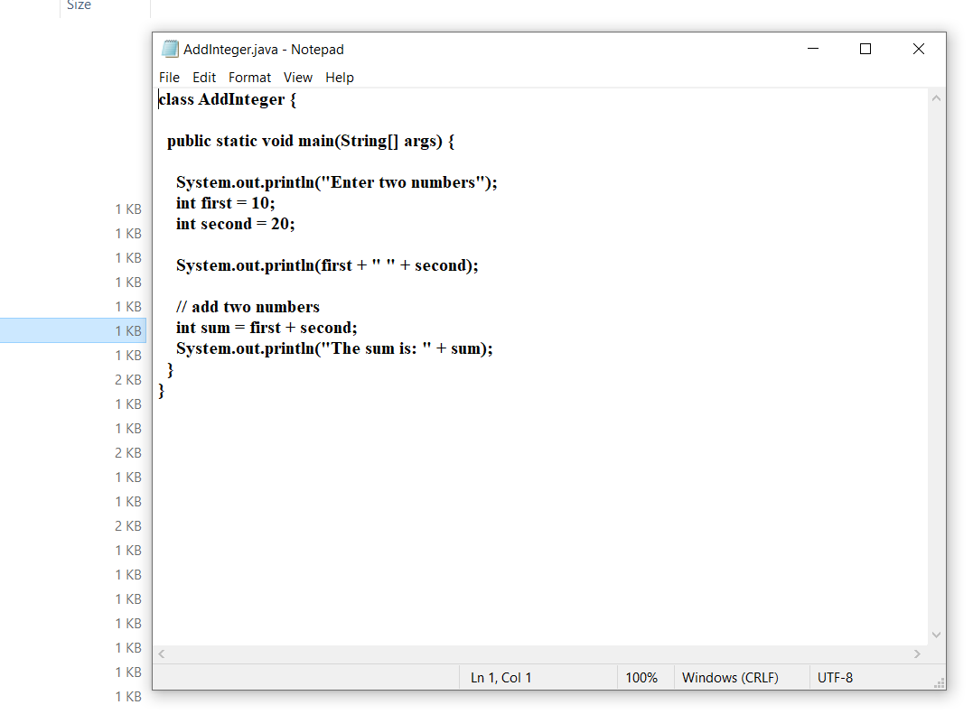

Slide 10
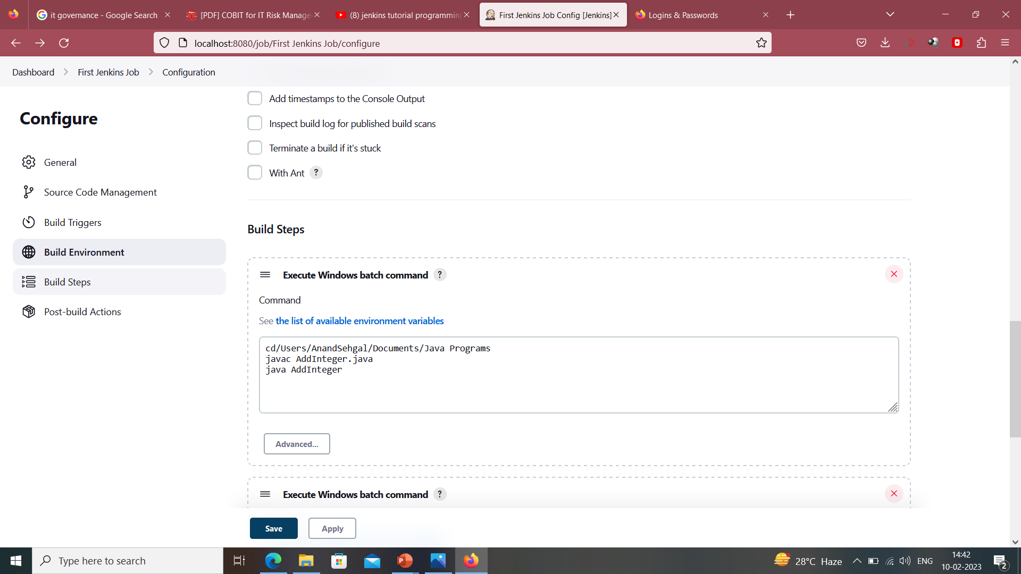

Slide 11
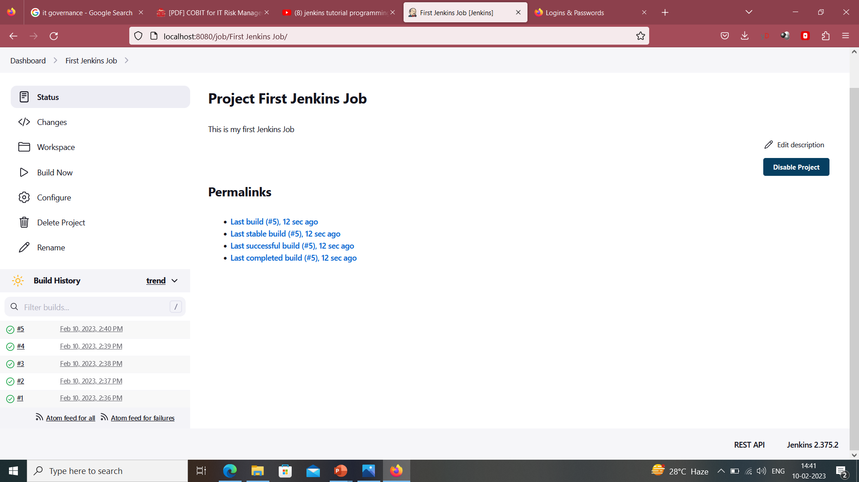

Slide 12
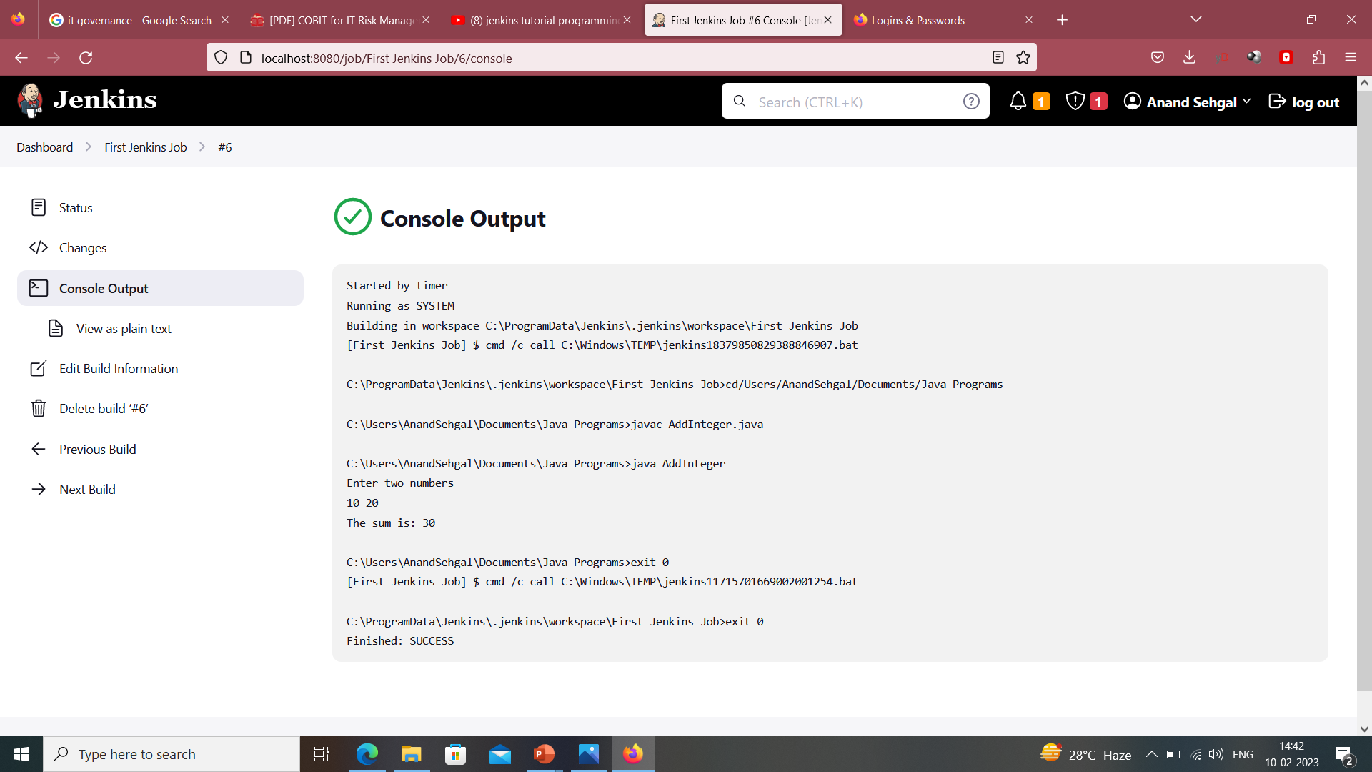

Slide 13
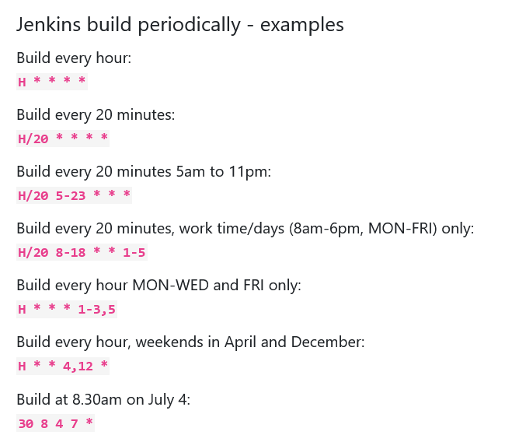
Jenkins Periodic Builds : Formats

Slide 14
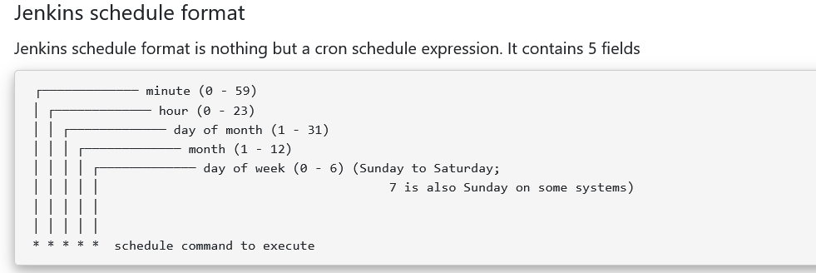

Slide 15
